Slide 1


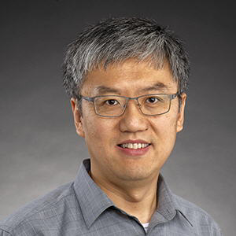

NoSQL Databases for Bioinformatics
Neo4j workshop
Information
Services
St. Jude Children’s Research Hospital
High Performance Computing Support
Yawei Hui
Ziang Zhang
Data Bases and Data Wrangling Series. Lecture#27
Notes:
Greeting. Introduce the lecturers and the HPC Support team. Read the title: today is the second hands-on session: after MongoDB (documents) we use a graph database to answer biological questions about genomes.
Everything runs on the students' laptops: Docker (Neo4j) + JupyterLab. The workbook is 4-neo4j-workshop/workbook.ipynb; SETUP.md in the repository explains the installation.

Slide 2

Learning Objectives
At the end of the session, you will be able to:
Model genomic data as a graph
Build genomic graph database with neo4j
Perform Biological insights via graph querying
• Identify similar genomes based on shared KOs annotations
• Infer evolutionary patterns of KOs across a phylogenetic structure.
Notes:
The three objectives of the session. Model: draw the whiteboard model of genomes, KOs and the tree. Build: import the data into Neo4j and verify it. Insights: (1) which genomes are similar, based on shared KO annotations; (2) how KO distributions evolved across the taxonomic tree.
The roadmap on the next slide follows the same order: Model, Import, Explore, Query.

Slide 3
Roadmap: from a table to insight in four steps
1 MODEL
2 IMPORT
3 EXPLORE
4 QUERY
Workbook §1-3
Workbook §4
Workbook §5
Workbook §6-7
Understand the data and the two questions
Whiteboard recipe: nouns → nodes, verbs → relationships
Warm-up: 4 genomes × 5 KOs, by hand
Constraints: uniqueness + index
Batch import with UNWIND … MERGE
Verify against the CSV files
Counts, one genome, one KO
Draw neighbourhoods and lineages
Distributions: genome size, KO sharing
Q1: which genomes are similar?
Q2: how did KOs evolve on the tree?
Insights: origin clade, signature KOs, gene loss
Everything is local: Docker (Neo4j) + JupyterLab → workbook: 4-neo4j-workshop/workbook.ipynb
NoSQL Databases for Bioinformatics · Lecture 27 · Neo4j genome workshop
‹#›
Notes:
Today we follow the four steps of every graph project: MODEL the data on a whiteboard, IMPORT it into Neo4j, EXPLORE what we built, and finally QUERY it to answer biological questions.
Each step matches a section of the workbook (4-neo4j-workshop/workbook.ipynb), so you can always find the code that belongs to a slide.
Everything runs on your laptop: the database is a Docker container (docker compose up -d) and the notebook is JupyterLab; no cloud account is needed. If your setup is not ready yet, SETUP.md in the repository explains it step by step and scripts/check_setup.py tests it.
Time plan (about 3 hours): Model 35 min, Import 30 min, Explore 20 min, Query 1 40 min, Query 2 45 min, wrap-up 10 min.

Slide 4
The biology: genomes, KOs and the tree of life
MODEL
Genome
KO = KEGG Orthology
The tree of life
The complete DNA of an organism
Predicted genes → proteins → what does it do?
Our data: 65 reference genomes (58 bacteria, 7 archaea): model organisms, pathogens, endosymbionts, cyanobacteria
A catalogue of gene functions, like part numbers
K04077 chaperonin GroEL
K02703 photosystem II D1 (psbA)
A genome = the set of KOs it carries: a functional fingerprint (E. coli: 3,047 KOs)
Relatives share recent ancestors → share genes
NCBI taxonomy:
domain › phylum › class › order › family › genus › species
⚠ taxonomy ≈ phylogeny, not identical
Raw material: 90,445 (genome, KO) pairs + a taxonomy tree + KEGG pathways
NoSQL Databases for Bioinformatics · Lecture 27 · Neo4j genome workshop
‹#›
Notes:
Before drawing any graph we need to understand what the data means.
A genome is the full DNA of an organism. We predict its genes, and for each gene product we ask: what does it do?
KEGG Orthology (KO) is a catalogue of gene functions, like part numbers in a parts catalogue. K04077 is the chaperonin GroEL, K02703 is the photosystem II D1 protein (psbA). If a genome has a gene labelled K04077, it can do that job. So each genome can be summarised by the set of KOs it carries, a functional fingerprint. E. coli K-12 has about 4,300 protein genes but 3,047 distinct KOs (some genes have no KO, some KOs are carried by several genes).
Life is a tree: related organisms share recent ancestors and therefore share genes. We use the NCBI taxonomy as our tree. It is not a perfect phylogeny (a real one is inferred from sequence alignments) but it follows evolution closely and it is a real hierarchy, which a graph handles beautifully.

Slide 5
Two questions we will answer
MODEL
Q1
Which genomes are similar?
Q2
Where are the KOs on the tree?
root
KO 1
clade A
clade B
Genome A
KO 2
Genome B
KO 3
a1
a2
b1
b2
Genomes a1, a2 carry the KO (orange): they meet in clade A
A and B share KO 1 and KO 2
Similar = many shared KOs: Genome → KO ← Genome
Walk up the tree from the genomes that carry a KO
NoSQL Databases for Bioinformatics · Lecture 27 · Neo4j genome workshop
‹#›
Notes:
Good graph projects start from questions, because the questions tell us which connections must be easy to follow.
Q1: which genomes have similar functional repertoires? Two genomes are similar when they are linked to many of the same KO nodes: a two-hop pattern Genome -> KO <- Genome.
Q2: how are KOs distributed over the tree? If we take every genome that carries a KO and walk up the tree, where do they meet? A KO whose carriers meet low in the tree, and which every member of that clade has, is a clade innovation. If the carriers only meet at the root, the KO is either ancient and often lost, or it moved between lineages (horizontal gene transfer).
Notice that both questions are about relationships, not about single records: that is the reason to use a graph.

Slide 6
The data: seven CSV files, 65 genomes
MODEL
File | One row is … | Rows | Becomes in the graph
genomes.csv | a genome (eco, bsu, …) | 65 | Genome nodes (+ CLASSIFIED_AS)
kos.csv | a KO (K04077 …) | 8,994 | KO nodes
taxa.csv | a taxonomic group | 270 | Taxon nodes
pathways.csv | a KEGG pathway | 356 | Pathway nodes
genome_ko.csv | genome carries KO (+ copies) | 90,445 | CONTAINS_KO relationships
taxon_tree.csv | taxon is a child of taxon | 269 | CHILD_OF relationships
ko_pathway.csv | KO takes part in pathway | 7,579 | IN_PATHWAY relationships
🔎 Look at the shape of the data. The three bottom files are lists of connections. In SQL they are link tables you must JOIN again and again; in a graph database each connection is stored directly and can be followed in constant time.
NoSQL Databases for Bioinformatics · Lecture 27 · Neo4j genome workshop
‹#›
Notes:
Everything the workshop needs is in the data/neo4j folder of the repository; nothing has to be downloaded. The files were prepared from KEGG (genome to KO annotations, KO names, pathways) and the NCBI Taxonomy (the lineage of each genome) by the script data/prepare/build_genome_graph_data.py.
Read the table as a data detective: what is one row? what identifies it? which column points to another file?
The key observation is in the last column: three files (genome_ko, taxon_tree, ko_pathway) are nothing but lists of connections between two things. In a relational database these are link tables that you JOIN again and again; in a graph database a connection is a first-class citizen. The last file column, species_taxid in genomes.csv, gives the 65 CLASSIFIED_AS relationships.

Slide 7
Why a graph? SQL vs Cypher
MODEL
SQL (relational)
Cypher (graph)
-- genomes sharing KOs: a self-join
SELECT a.genome_id, b.genome_id, COUNT(*)
FROM genome_ko a
JOIN genome_ko b ON a.ko_id = b.ko_id
AND a.genome_id < b.genome_id
GROUP BY a.genome_id, b.genome_id;
-- all ancestors of a taxon: recursion
WITH RECURSIVE up AS (
SELECT taxid, parent FROM tree
WHERE taxid = 562
UNION ALL
SELECT t.taxid, t.parent FROM tree t
JOIN up ON t.taxid = up.parent)
SELECT * FROM up;
// genomes sharing KOs: draw the pattern
MATCH (a:Genome)-[:CONTAINS_KO]->(k:KO)
<-[:CONTAINS_KO]-(b:Genome)
WHERE a.genome_id < b.genome_id
RETURN a.genome_id, b.genome_id, count(k)
// all ancestors of a taxon
MATCH (t:Taxon {taxid: 562})
-[:CHILD_OF*]->(ancestor)
RETURN ancestor
Connections are stored
The query looks like the question
Depth need not be known
following a link is a pointer hop, not a computed JOIN
* follows a relationship any number of times
draw the pattern with ASCII art
NoSQL Databases for Bioinformatics · Lecture 27 · Neo4j genome workshop
‹#›
Notes:
This slide is the motivation for the whole afternoon. The question 'which genomes share KOs?' needs a self-join of the biggest table in SQL. The question 'what are all the ancestors of this taxon?' needs a recursive query because the depth of the tree is not known in advance.
In Cypher both are drawn as patterns. In MATCH (a:Genome)-[:CONTAINS_KO]->(k:KO)<-[:CONTAINS_KO]-(b:Genome) the round brackets are nodes and the arrows are relationships: the query looks like the picture you would draw on a whiteboard. -[:CHILD_OF*]-> means 'follow CHILD_OF one or more times'.
You can do both in SQL; the point is that the graph version is shorter, closer to the question, and stays fast when the data grows because following a stored connection does not require computing a join.

Slide 8
Modelling recipe: nouns, verbs, attributes
MODEL
Step | Ask yourself | Rule of thumb | In our data
1 | What are the things? | nouns → nodes (each kind gets a label) | Genome, KO, Taxon, Pathway
2 | How are they connected? | verbs → relationships (type + direction) | CONTAINS_KO, CLASSIFIED_AS, CHILD_OF, IN_PATHWAY
3 | What do I know about them? | attributes → properties (key–value) | genome_id, name, rank … and copies on CONTAINS_KO
4 | Which questions will I ask? | a link that is followed often → a relationship | Q1: Genome → KO ← Genome · Q2: walk up CHILD_OF
💡 Tip: draw the model first, with circles and arrows, then write code. If you cannot say a relationship as a sentence (“a Genome CONTAINS_KO a KO”), the model is probably wrong.
NoSQL Databases for Bioinformatics · Lecture 27 · Neo4j genome workshop
‹#›
Notes:
Graph modelling is easiest on a whiteboard. The recipe has four questions.
1. What are the things in my data? The nouns become nodes, and every kind of thing gets a label (Genome, KO, Taxon, Pathway).
2. How are the things connected? The verbs become relationships. A relationship has a type, a direction and can carry properties.
3. What do I know about each thing or connection? These attributes become properties (key-value pairs), on nodes and on relationships.
4. Which questions will I ask? If a question often follows a link, that link should be a relationship, not a property.
The right column shows the answers for our data. Pause here and let students propose the model before showing the next slide.

Slide 9
Our graph model
MODEL
genome_id · name
assembly · n_protein_genes
ko_id · name
symbol · definition
pathway_id · name
CONTAINS_KO
{copies}
Genome
KO
IN_PATHWAY
Pathway
CLASSIFIED_AS
The tree = CHILD_OF repeated:
(:Taxon)-[:CHILD_OF]->(:Taxon)
Taxon
CHILD_OF
Taxon
(its parent)
Node = noun · label
Relationship = verb · type + direction
Properties = attributes, on nodes and relationships
taxid · name · rank
rank_level
NoSQL Databases for Bioinformatics · Lecture 27 · Neo4j genome workshop
‹#›
Notes:
This is the model we will build. Four kinds of nodes: Genome, KO, Taxon (a group in the tree of life) and Pathway.
Four kinds of relationships. CONTAINS_KO connects a genome to the KOs it carries and has a property, copies, the number of genes with that function. CLASSIFIED_AS connects a genome to its species. CHILD_OF links each taxon to its parent: the whole tree of life is stored as nodes and CHILD_OF relationships. IN_PATHWAY connects a KO to the KEGG pathways it takes part in.
Properties are written next to the node they belong to. Note that every node type has a 'name' property: this is only a convenience, it gives every node a readable caption in drawings.
Neo4j can draw its own schema from the data (CALL db.schema.visualization()), which is a good check that the loaded graph looks like the whiteboard model.

Slide 10
Design decisions: the “why” behind the model
MODEL
KO is a node, not a list property
copies lives on the relationship
Genome.kos = [...] would force a scan of every genome to answer “who has K04077?”. As a node, the KO knows its genomes (Q1 = two hops).
Copy number describes the pair (this genome, this KO), not the genome and not the KO alone.
The tree is nodes + CHILD_OF
Genome → species only
A column “phylum” only answers questions you foresaw. A tree answers any clade, any depth with one pattern, and a new rank changes no query.
Ancestors are always one traversal away. Store each fact once; redundant links would have to be kept in sync.
NoSQL Databases for Bioinformatics · Lecture 27 · Neo4j genome workshop
‹#›
Notes:
These choices matter more than syntax. Ask the students to defend the opposite choice.
1. KO as a node, not a list property on the genome. With a list, 'which genomes have K04077?' scans every genome and searches its list. As a node, K04077 knows its genomes, and Q1 becomes a two-step walk.
2. copies on the relationship. Copy number describes the pair (this genome, this KO), not the genome and not the KO alone.
3. A tree of Taxon nodes instead of columns phylum/class/... in the genome table. Columns only answer questions about ranks you foresaw. A tree answers questions about any clade at any depth with one pattern, and adding a rank later changes no query.
4. A genome links only to its species. Ancestors are one traversal away, so we store each fact once instead of keeping redundant links in sync.
Extra: arrow direction is only how the relationship is stored. You can traverse it in either direction, or ignore it.

Slide 11
Warm-up: a graph you can check by eye
MODEL
Similarity to E. coli (eco)
eco
groEL
genome | shared | Jaccard
bsu | 3 | 0.75
mge | 2 | 0.67
syn | 2 | 0.50
rpoB
bsu
fliC
syn
Raw count: B. subtilis wins.
But M. genitalium (2 KOs, both shared) beats Synechocystis on Jaccard just because it is small.
→ normalise before interpreting counts (see the Jaccard slide).
spo0A
mge
psbA
CONTAINS_KO relationships: 12 · nodes: 9
NoSQL Databases for Bioinformatics · Lecture 27 · Neo4j genome workshop
‹#›
Notes:
Before importing 98,000 relationships we build a graph so small that every answer can be verified by eye: 4 genomes and 5 KOs, all real KEGG Orthology IDs. groEL and rpoB are universal. fliC (flagellin) is in E. coli and B. subtilis. spo0A (sporulation) is only in B. subtilis. psbA (photosystem II) is only in Synechocystis.
In the workbook this graph is created with MERGE statements (get-or-create), drawn with the interactive viewer, and queried: starting at E. coli, walk to its KOs, then to the other genomes that carry the same KOs, and count.
The table on the right shows the answer. By raw count B. subtilis wins (3 shared KOs). But look at the Jaccard column: M. genitalium (only 2 KOs, both shared with E. coli) looks more similar to E. coli than Synechocystis does, simply because it is tiny. We will meet this problem again with real data.

Slide 12
Cypher in 60 seconds
MODEL
(g:Genome {genome_id: 'eco'})
-[:CONTAINS_KO {copies: 1}]->
(k:KO {ko_id: 'K04077'})
keyword | does
MATCH | find a pattern
WHERE | filter
RETURN | give results back
CREATE | always creates (twice = 2 nodes!)
MERGE | get-or-create: safe to re-run
SET | add / change properties
ORDER BY LIMIT | sort, cut
piece | meaning
( ) | a node (a circle on the whiteboard)
g | a variable: a name you choose, to refer to the node later
:Genome | the node's label (its kind)
{genome_id: 'eco'} | properties to match or to set
-[ ]-> | a relationship; arrow = stored direction
:CONTAINS_KO | the relationship's type
No GROUP BY! Use an aggregate (count, collect) and every other column in RETURN becomes the grouping key.
NoSQL Databases for Bioinformatics · Lecture 27 · Neo4j genome workshop
‹#›
Notes:
Cypher draws patterns with characters: parentheses are circles (nodes) and arrows are relationships. Inside the parentheses, a name before the colon is a variable you choose, the word after the colon is the label, and curly braces hold properties. Relationships are written in square brackets with their type.
The keywords you need today: MATCH finds patterns; WHERE filters; RETURN gives results back; CREATE always makes something new (run it twice and you get two); MERGE is get-or-create and is safe to re-run, so use it to load data; SET adds or changes properties.
There is no GROUP BY in Cypher: as soon as you use an aggregate (count, collect, ...), every non-aggregated column in RETURN becomes the grouping key.
A cheat sheet with more syntax is on the last slide and in Appendix A of the workbook.

Slide 13
Import 1: constraints first
IMPORT
CREATE CONSTRAINT genome_id IF NOT EXISTS
FOR (g:Genome) REQUIRE g.genome_id IS UNIQUE;
CREATE CONSTRAINT ko_id IF NOT EXISTS
FOR (k:KO) REQUIRE k.ko_id IS UNIQUE;
CREATE CONSTRAINT taxon_id IF NOT EXISTS
FOR (t:Taxon) REQUIRE t.taxid IS UNIQUE;
CREATE CONSTRAINT pathway_id IF NOT EXISTS
FOR (p:Pathway) REQUIRE p.pathway_id IS UNIQUE;
Integrity
No duplicates, even if you import twice.
Speed
Each constraint builds an index: look-ups jump straight to the node.
Why does this matter?
Wave 2 of the import runs 90,445 × 2 look-ups like MATCH (g:Genome {genome_id: …}).
Without an index each look-up scans all nodes with that label → minutes. With the index → seconds (our whole import: ~6 s).
IF NOT EXISTS makes the statements safe to repeat: the notebook is re-runnable.
NoSQL Databases for Bioinformatics · Lecture 27 · Neo4j genome workshop
‹#›
Notes:
Before loading any data we create uniqueness constraints: 'no two Genome nodes may have the same genome_id', and so on for KO, Taxon and Pathway.
Two benefits. Integrity: a typo or a repeated import cannot silently create duplicates. Speed: Neo4j automatically builds an index behind each constraint. When the second wave of the import says MATCH (g:Genome {genome_id: 'eco'}), it jumps straight to that node instead of scanning all genomes. Without these indexes, the 90,000 relationships (two look-ups each) would take minutes instead of seconds.
The IF NOT EXISTS clause makes each statement safe to repeat, which keeps the whole notebook re-runnable. The workbook starts the import by emptying the database (MATCH (n) DETACH DELETE n), so you can always start over.

Slide 14
Import 2: UNWIND … MERGE in batches
IMPORT
rows = read_csv_rows("genome_ko.csv") # list of dicts
for r in rows: # csv gives TEXT:
r["copies"] = int(r["copies"]) # convert numbers!
for batch in chunks(rows, 5000):
run("""
UNWIND $rows AS row
MATCH (g:Genome {genome_id: row.genome_id})
MATCH (k:KO {ko_id: row.ko_id})
MERGE (g)-[r:CONTAINS_KO]->(k)
SET r.copies = row.copies
""", rows=batch)
CSV file
Python: dicts, int()
batch of 5,000 rows
Neo4j: UNWIND + MERGE
Order matters: nodes first, relationships second · MERGE = get-or-create: the import is re-runnable · batches: not 1 row, not 90,000 rows
NoSQL Databases for Bioinformatics · Lecture 27 · Neo4j genome workshop
‹#›
Notes:
The import is two waves. Wave 1 creates the nodes (Genome, KO, Taxon, Pathway). Wave 2 creates the relationships, because a relationship needs both end nodes to exist.
Python reads the CSV into a list of dictionaries (csv.DictReader). Everything the csv module returns is text, so numbers must be converted in Python (int(...)); otherwise Neo4j would store the text '4288' and a comparison like n_protein_genes > 4000 would not work.
The rows are sent to Neo4j in batches of 5,000. One row per query would need 90,000 network round-trips, and one giant transaction needs a lot of memory; a few thousand rows per transaction is the usual sweet spot.
UNWIND $rows AS row turns a list parameter into one result row per item, and the rest of the query then runs once per row, like a for-loop written in Cypher. We use MERGE, so running the import twice does not create duplicates. Putting only the identifying property inside the MERGE braces and using SET for the rest is the safe pattern.
Neo4j can also read CSV files itself (LOAD CSV); the workbook shows a read-only preview, and the import folder is mounted by docker-compose.

Slide 15
Never trust an import: verify it
IMPORT
 | in database | in CSV files | OK?
Genome | 65 | 65 | ✅
KO | 8,994 | 8,994 | ✅
Taxon | 270 | 270 | ✅
Pathway | 356 | 356 | ✅
CONTAINS_KO | 90,445 | 90,445 | ✅
CHILD_OF | 269 | 269 | ✅
CLASSIFIED_AS | 65 | 65 | ✅
IN_PATHWAY | 7,579 | 7,579 | ✅
In 6 seconds
9,685 nodes · 98,358 relationships on a laptop.
Three checks
Counts vs the CSV files (table)
Schema: CALL db.schema.visualization()
Spot check: E. coli = 4,288 protein genes, 3,047 distinct KOs
NoSQL Databases for Bioinformatics · Lecture 27 · Neo4j genome workshop
‹#›
Notes:
A classic data-engineering rule: compare what is in the database with what was in the files. Any difference means a bug in the import. The table is the output of the check cell in the workbook: counts per label and per relationship type in the database, against the number of rows in the CSV files, with a check mark when they agree.
The whole import took about 6 seconds on a laptop: 9,685 nodes and 98,358 relationships.
Two more checks: Neo4j can draw its own schema from the loaded data (CALL db.schema.visualization()) which you can compare with the whiteboard model; and a spot check of a record you know. E. coli K-12 should have 4,288 protein genes and 3,047 distinct KOs.

Slide 16
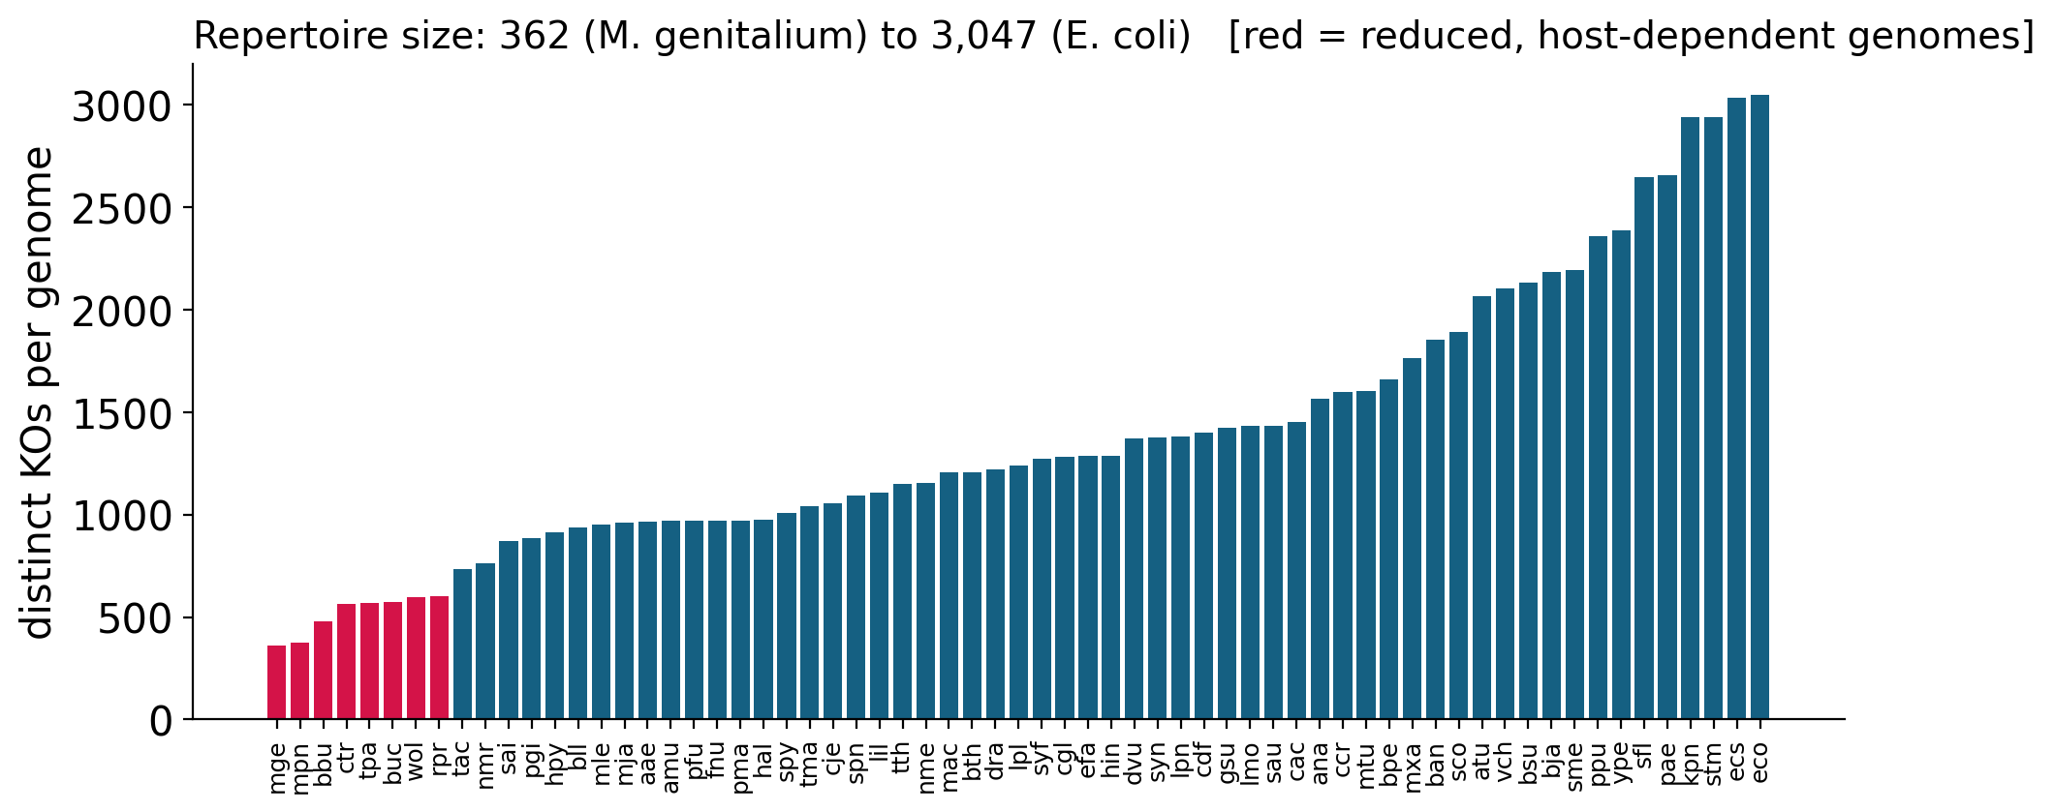
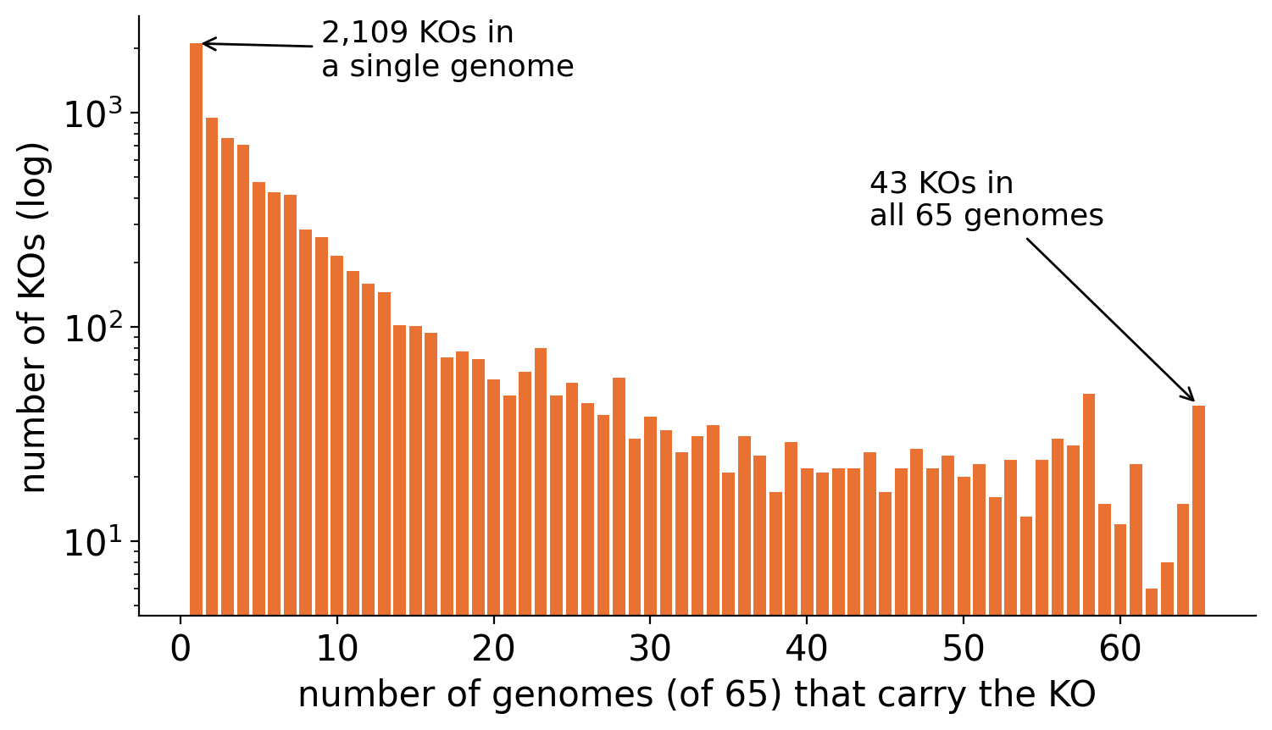
Explore: how big, how shared?
EXPLORE
Reduced genomes (red) are parasites and endosymbionts: they threw away functions their host provides
Sizes range 8×: 362 → 3,047 KOs
A U-shape, typical of pan-genomes: a small core (43 KOs in all genomes) and a large cloud of rare KOs
Only one genome has 2,109 of the KOs
Pan-genome shape: a small core everybody needs + a huge cloud of rare, lineage-specific functions
NoSQL Databases for Bioinformatics · Lecture 27 · Neo4j genome workshop
‹#›
Notes:
Before asking clever questions, look around. Two numbers shape everything that follows.
How many KOs does a genome have? From 362 (Mycoplasma genitalium) to 3,047 (E. coli), a factor of 8. The smallest repertoires (shown in red) belong to parasites and endosymbionts that live inside other cells and threw away functions their host provides: Mycoplasma, Borrelia, Chlamydia, Treponema, Buchnera, Rickettsia, Wolbachia.
How many genomes share each KO? The distribution is U-shaped, the signature of microbial pan-genomes: a small core of 43 KOs that every one of the 65 genomes has (ribosomal proteins, tRNA synthetases, chaperones) and a huge cloud of rare functions: 2,109 KOs occur in a single genome.
In the workbook we also draw neighbourhoods with the interactive viewer (always add LIMIT when drawing: a genome has about 3,000 neighbours).

Slide 17
Query 1: which genomes are similar?
QUERY 1
MATCH (a:Genome {genome_id: $gid})
-[:CONTAINS_KO]->(k:KO)
<-[:CONTAINS_KO]-(b:Genome)
WHERE a <> b
WITH a, b, count(k) AS shared
WITH b, shared,
COUNT { (a)-[:CONTAINS_KO]->() } AS size_a,
COUNT { (b)-[:CONTAINS_KO]->() } AS size_b
RETURN b.name, shared,
round(1.0*shared/(size_a+size_b-shared), 3)
AS jaccard
KO
Genome a
KO
Genome b
KO
count(k) = number of shared KOs of the pair
E. coli K-12 is closest to … | shared KOs | Jaccard
E. coli O157:H7 (ecs) | 2,827 | 0.869
Shigella flexneri (sfl) | 2,513 | 0.791
Salmonella Typhimurium (stm) | 2,555 | 0.745
Klebsiella pneumoniae (kpn) | 2,485 | 0.710
Yersinia pestis (ype) | 2,060 | 0.611
The graph rediscovers taxonomy from KO annotations alone: the nearest genomes are the other Enterobacteriaceae.
NoSQL Databases for Bioinformatics · Lecture 27 · Neo4j genome workshop
‹#›
Notes:
Question Q1 is answered by a two-hop pattern: start at a genome, walk to each KO it carries, then walk to every other genome that carries the same KO, and count how many KOs we passed through for each other genome.
In Cypher the sentence is drawn as the pattern (a:Genome)-[:CONTAINS_KO]->(k:KO)<-[:CONTAINS_KO]-(b:Genome). The WHERE a <> b clause skips the comparison of the genome with itself. count(k) counts the shared KOs per pair; COUNT { (a)-[:CONTAINS_KO]->() } is a counting sub-query that gives the size of each repertoire (the degree of the node).
For E. coli the best matches are its relatives: E. coli O157:H7 (Jaccard 0.87), Shigella (0.79), Salmonella (0.75), Klebsiella (0.71), then Yersinia. The graph rediscovered taxonomy using only KO annotations.
The score in the last column, the Jaccard index, is explained on the next slide.

Slide 18
Why raw counts mislead: the Jaccard index
QUERY 1
Closest genomes to Buchnera (571 KOs) by …
raw shared KOs | shared | genome size
Salmonella (stm) | 565 | 2,939
E. coli (eco) | 563 | 3,047
E. coli O157 (ecs) | 562 | 3,033
Yersinia (ype) | 560 | 2,386
Shigella (sfl) | 548 | 2,644
Jaccard index | Jaccard | genome size
Wolbachia (wol) | 0.405 | 595
Rickettsia (rpr) | 0.358 | 601
Chlamydia (ctr) | 0.350 | 564
Aquifex (aae) | 0.348 | 964
Treponema (tpa) | 0.344 | 570
Jaccard index
🤔 Think: Buchnera and Chlamydia are in different phyla.
Both lost most of their metabolism inside host cells: convergent genome reduction.
Similar repertoire = similar lifestyle and ancestry.
J(A, B) = |A ∩ B| / |A ∪ B|
= shared / (size A + size B − shared)
1 = identical · 0 = nothing in common
NoSQL Databases for Bioinformatics · Lecture 27 · Neo4j genome workshop
‹#›
Notes:
A genome with 3,000 KOs will share a lot with everybody; a genome with 400 KOs can never share more than 400. So the number of shared KOs mostly measures size.
Buchnera is an aphid endosymbiont with only 571 KOs. By raw count its closest genomes are the big famous ones: Salmonella, E. coli, Yersinia, Shigella share about 560 of its 571 KOs, but they have 3,000 KOs each, so most of what they carry is irrelevant to Buchnera. By Jaccard index the winners are Wolbachia, Rickettsia, Chlamydia, Aquifex and Treponema: small, host-dependent genomes whose repertoires have the same shape as Buchnera's.
The Jaccard index measures overlap relative to the union of the two sets: shared / (size A + size B - shared). It is 1 for identical repertoires and 0 for nothing in common. The union is A + B - shared because the shared KOs would otherwise be counted twice.
Discussion point: is similar functional repertoire the same as closely related? Buchnera and Chlamydia are in different phyla, but both lost most of their metabolism after moving into host cells: convergent genome reduction. Functional similarity captures lifestyle as well as ancestry.

Slide 19
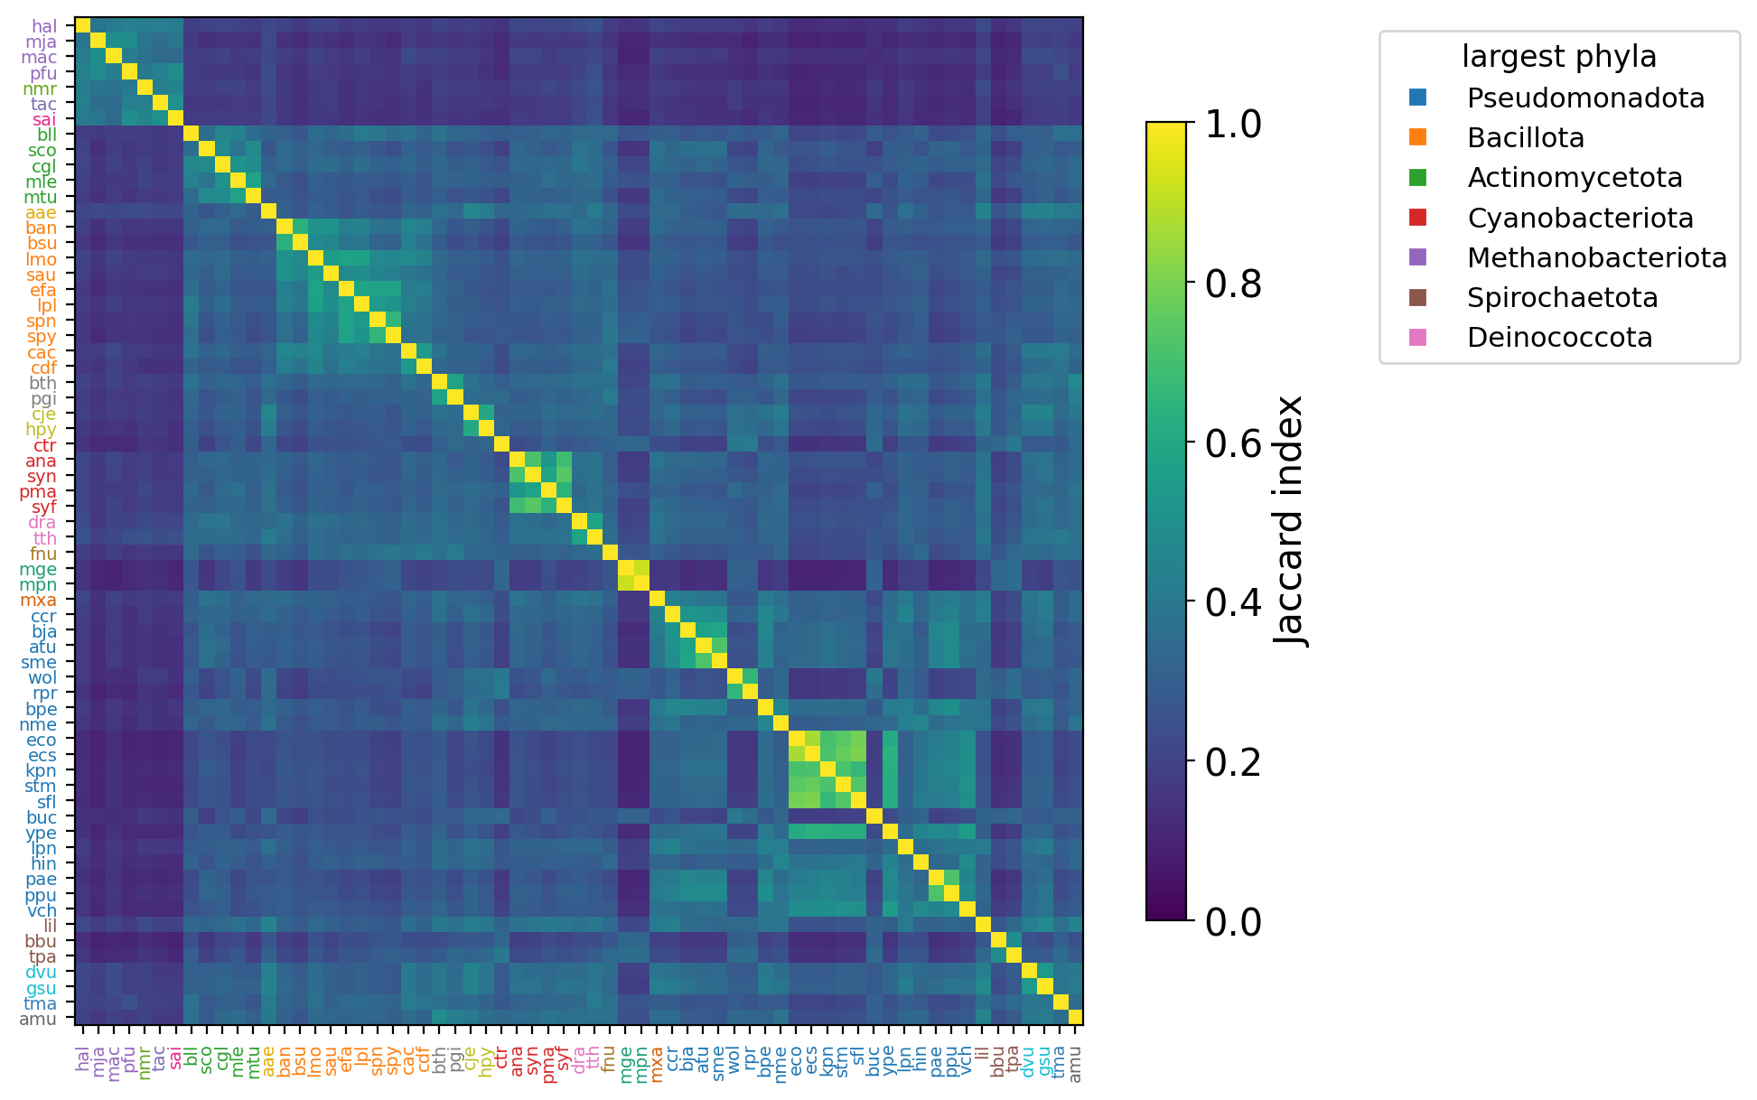
Similarity recovers taxonomy
QUERY 1
83%
of genomes have their nearest neighbour in the same phylum
9 of 11
exceptions are the only genome of their phylum in the sample: no neighbour to find
Genomes sorted by taxonomy, not by similarity
Bright diagonal blocks = groups of alike genomes
→ the KO repertoire is a fingerprint of ancestry
NoSQL Databases for Bioinformatics · Lecture 27 · Neo4j genome workshop
‹#›
Notes:
We computed the Jaccard index for all 2,080 pairs of genomes in one Cypher query (one row per pair, each pair once) and drew the matrix. The genomes are sorted by taxonomy (domain, phylum, class, ...), not by similarity, yet bright blocks appear along the diagonal: the archaea in the top-left corner, the Actinomycetota, the Bacillota, the cyanobacteria, the E. coli / Shigella / Salmonella / Klebsiella square, the Mycoplasma pair. The KO repertoire is a good fingerprint of ancestry.
A quantitative check: for each genome we looked at its single most similar genome. In 83% of the cases it is in the same phylum. Of the 11 exceptions, 9 are phyla represented by only one genome in our sample, so a same-phylum neighbour does not exist: the method had no chance to be right. The agreement drops at the genus and family level mainly because most genera in our sample have a single genome.
In the workbook we also build a dendrogram (hierarchical clustering with distance 1 - Jaccard), where same-coloured labels end up together.

Slide 20
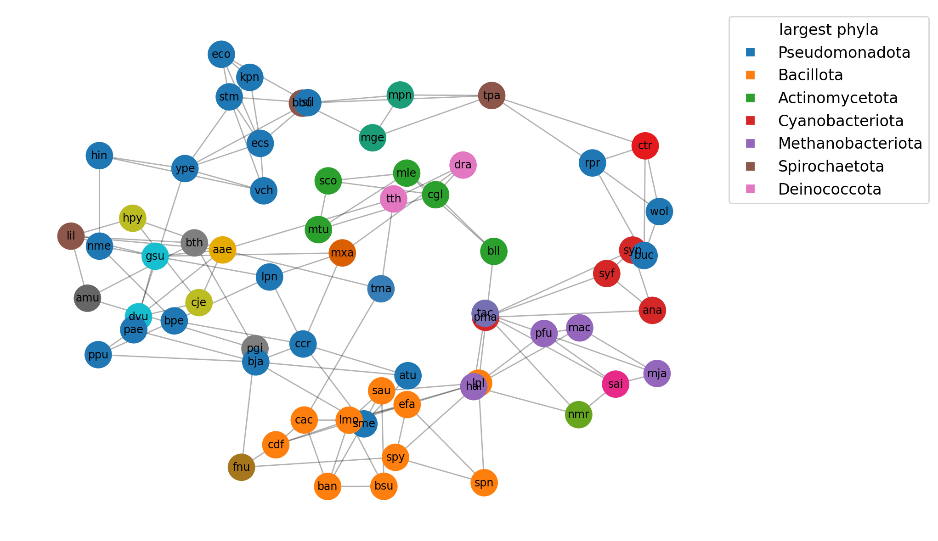
Save the neighbours in the graph
QUERY 1
... jaccard per pair (a, b) ...
ORDER BY a.genome_id, jaccard DESC
WITH a, collect({genome: b,
jaccard: jaccard})[0..3] AS top3
UNWIND top3 AS nb
MERGE (a)-[s:SIMILAR_TO]->(nb.genome)
SET s.jaccard = round(nb.jaccard, 3)
Materialise results as relationships: later queries just follow them
195 SIMILAR_TO relationships (65 × 3)
NoSQL Databases for Bioinformatics · Lecture 27 · Neo4j genome workshop
‹#›
Notes:
Computing all-pairs similarity is cheap here, but with millions of genomes it would not be. A very common pattern is to materialise a result as new relationships so that later queries can simply follow them. We link each genome to its three nearest neighbours with a SIMILAR_TO relationship that carries the Jaccard score: a k-nearest-neighbour graph, computed entirely inside Neo4j.
The query sorts the pairs by genome and score, keeps the first three per genome with collect(...)[0..3], unwinds them and MERGEs the relationships. The picture shows the whole kNN graph (drawn with networkx, coloured by phylum): clusters of the same colour are groups of related genomes; reduced genomes such as Mycoplasma and Borrelia / Treponema attract each other.
In the Neo4j Browser or in the workbook you can explore the same neighbourhood interactively, for example (:Genome {genome_id:'eco'})-[:SIMILAR_TO*1..2]-(:Genome).
Takeaways of Query 1: similarity search is a 2-hop pattern with no join tables; normalise (Jaccard) before you interpret counts; results can be written back into the graph; functional similarity mirrors, but is not identical to, ancestry.

Slide 21
Query 2: the tree is nodes and CHILD_OF
QUERY 2
root
cellular organisms
Variable-length patterns
pattern | follows CHILD_OF …
-[:CHILD_OF]-> | exactly once (the parent)
-[:CHILD_OF*2]-> | exactly twice
-[:CHILD_OF*1..3]-> | 1 to 3 times
-[:CHILD_OF*]-> | 1 or more times: all ancestors
-[:CHILD_OF*0..]-> | 0 or more: the node itself + ancestors
domain
Bacteria
phylum
Pseudomonadota
class
Gammaproteobacteria
order
Enterobacterales
family
Enterobacteriaceae
MATCH (g:Genome)-[:CLASSIFIED_AS]->(:Taxon)
-[:CHILD_OF*0..]->(t:Taxon)
RETURN t.name, count(DISTINCT g) AS genomes
genus
Escherichia
CHILD_OF ×7
species
Escherichia coli
CLASSIFIED_AS
Clade sizes, stored once as Taxon.n_genomes: OPTIONAL MATCH ≈ LEFT JOIN
genome
Genome eco
NoSQL Databases for Bioinformatics · Lecture 27 · Neo4j genome workshop
‹#›
Notes:
Question Q2 needs the tree. In the graph, the tree of life is just Taxon nodes connected by CHILD_OF relationships that point from a group to its parent. A genome is attached to its species with CLASSIFIED_AS.
Walking up the tree is a variable-length pattern: -[:CHILD_OF*]-> means 'follow CHILD_OF as many times as needed'. *0.. includes the node itself. In SQL the same question needs a recursive query. In a graph with cycles an unbounded star can explode, so get used to bounding long paths (*..10); our tree has no cycles, so it is safe.
The left side shows the full lineage of E. coli K-12, from species up to the root, which is the result of
MATCH p = (:Genome {genome_id:'eco'})-[:CLASSIFIED_AS]->(:Taxon)-[:CHILD_OF*0..]->(:Taxon {rank:'root'}).
We also store the number of genomes below each taxon as a property (n_genomes), computed once with OPTIONAL MATCH and count(DISTINCT g), because later queries use it.

Slide 22
Same query, different evolutionary stories
QUERY 2
KO | function | where in the tree? | story
psbA | photosystem II D1 (photosynthesis) | Cyanobacteriota: 4 / 4 | one innovation, inherited by the whole clade
spo0A | sporulation master regulator | Bacillota: 4 / 10 | innovation of a sub-group (spore formers)
nifH | nitrogenase (fixes N2 gas) | 9 genomes in 6 phyla, e.g. Pseudomonadota 2/20, Bacillota 1/10, Methanobacteriota 2/4 | patchy: repeated loss and/or horizontal transfer
groEL | chaperonin GroEL | all 20 phyla: 65 / 65 | ancestral, essential
MATCH (k:KO {ko_id: $ko})<-[:CONTAINS_KO]-(g:Genome)
-[:CLASSIFIED_AS]->(:Taxon)-[:CHILD_OF*0..]->(c:Taxon {rank: 'phylum'})
RETURN c.name, c.n_genomes, count(DISTINCT g) AS with_ko
Walk up from the carriers, then count per clade.
NoSQL Databases for Bioinformatics · Lecture 27 · Neo4j genome workshop
‹#›
Notes:
For one KO we walk up from every genome that carries it to the clades above, and count per phylum how many of the clade's genomes have it. The same query gives very different pictures.
psbA (photosystem II, photosynthesis) is found only in the Cyanobacteriota, and in all four of them: one innovation, inherited by the whole clade.
spo0A (master regulator of sporulation) is found only in Bacillota, but only 4 of its 10 genomes have it: an innovation of a sub-group, the spore formers; the others lost it or never had it.
nifH (nitrogenase, fixes nitrogen gas) is found in 9 genomes spread over 6 phyla and both domains, a minority within each of the large phyla (2 of 20 Pseudomonadota, 1 of 10 Bacillota): a patchy distribution, explained by many losses and/or horizontal gene transfer.
groEL (chaperonin) is in all 65 genomes: ancestral and essential.

Slide 23
Origin clade: lowest common ancestor + coverage
QUERY 2
Example 1
Example 2
root
root
clade A
clade B
clade A
clade B
a1
a2
a3
b1
b2
a1
a2
a3
b1
b2
LCA = clade A · coverage 3/3 = 1.0 → one gain, inherited
LCA = root · coverage 2/5 = 0.4 → patchy
1
collect
2
walk up
3
keep
4
deepest
the carriers of each KO
CHILD_OF*0.. from every carrier
ancestors above all carriers
= LCA; coverage = carriers / clade size
NoSQL Databases for Bioinformatics · Lecture 27 · Neo4j genome workshop
‹#›
Notes:
Can we summarise 'where does this KO live in the tree' as one relationship? We use parsimony, 'the simplest explanation'. Find the smallest clade that contains every genome that has the KO: their lowest common ancestor (LCA). The simplest story is that the KO first appeared in the ancestor of that clade. Then measure the coverage: genomes with the KO divided by all genomes in that clade.
Left example: carriers a1, a2, a3. The smallest clade containing them is clade A and coverage is 3 of 3: one gain in the ancestor of A, inherited by everyone. Right example: carriers a1 and b2. The smallest clade containing them is the root and coverage is 2 of 5 = 0.4: patchy. Either the KO was gained at the root and lost three times, or it was gained twice independently (or transferred).
In Cypher: (1) collect the carriers of each KO; (2) from each carrier walk up CHILD_OF*0.. to every ancestor and count how many carriers sit below it; (3) keep the ancestors above ALL carriers; (4) order by rank_level descending and keep the first: the deepest, i.e. the lowest common ancestor. We store the result as (:KO)-[:ORIGIN_CLADE {carriers, clade_size, coverage}]->(:Taxon) for all 8,994 KOs in about one second.

Slide 24
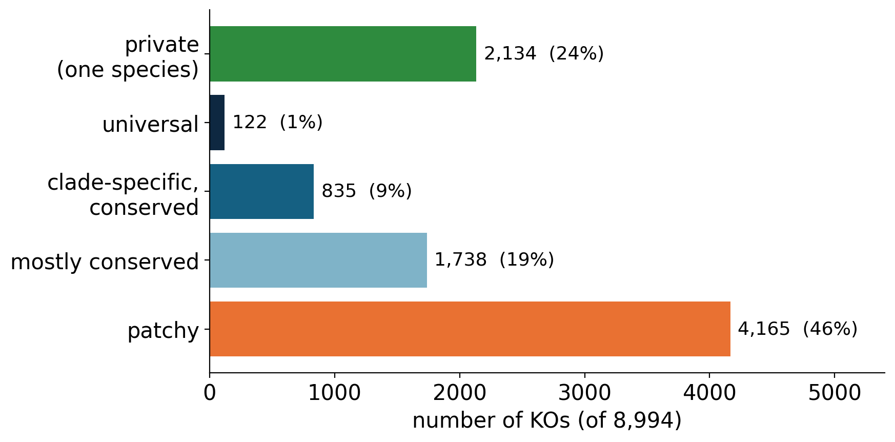
Most KOs are patchy: patterns of KO evolution
QUERY 2
KO | origin clade | coverage
groEL | root | 1.00
psbA | Cyanophyceae (= all cyanobacteria) | 1.00
rpoB | Bacteria | 0.95
fliC | Bacteria | 0.48
spo0A | Bacillota | 0.40
nifH | root | 0.14
Thresholds are our choice: change them and see how the numbers move. Patchy KOs mark where horizontal gene transfer and repeated gene loss shape genomes.
universal: origin = root, coverage ≥ 0.9
clade-specific: origin below root, coverage ≥ 0.9
patchy: coverage < 0.5 (loss and/or transfer)
NoSQL Databases for Bioinformatics · Lecture 27 · Neo4j genome workshop
‹#›
Notes:
With one ORIGIN_CLADE relationship per KO, classifying every KO is a simple CASE expression: private (the origin clade is a single species), universal (origin is the root and coverage at least 0.9), clade-specific and conserved (origin below the root, coverage at least 0.9), mostly conserved (coverage 0.5 to 0.9) and patchy (coverage below 0.5). The thresholds are our own choice; students should change them and see how the numbers move.
Result: only 1.4% of the KOs are universal and 9% are clean clade-specific innovations; 24% are private to one species; and almost half (46%) are patchy. The flexible part of bacterial genomes is shaped by horizontal gene transfer and repeated gene loss, not by tidy inheritance: microbial evolution is often described as a network rather than a tree.
The table gives six case studies: groEL is ancestral to everything (coverage 1.0); rpoB is ancestral to Bacteria; psbA is a textbook clade innovation (Cyanophyceae is the only class of the phylum in our sample, so it has the same four genomes); spo0A belongs to Bacillota with coverage 0.4; fliC (flagellin) is patchy in Bacteria; nifH is very patchy over the whole tree.

Slide 25
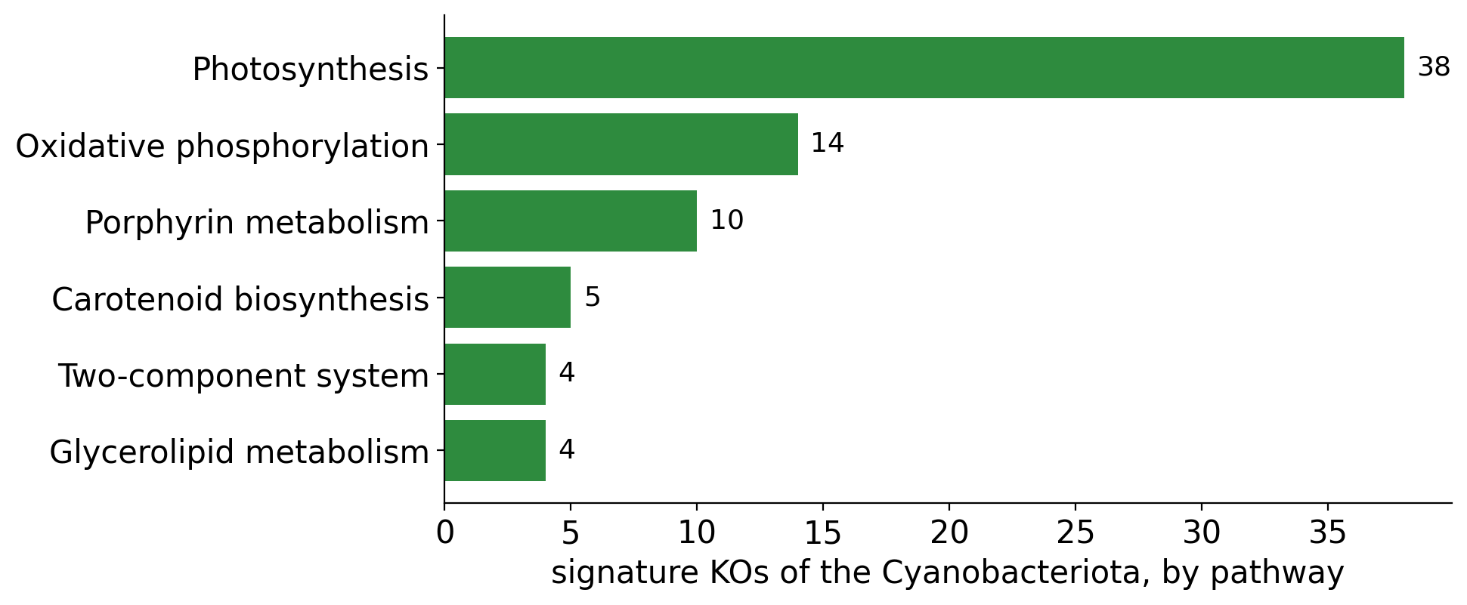
Signature KOs: what defines a clade?
QUERY 2
104 signature KOs
found in all 4 cyanobacteria, in no other genome
What are they?
Photosystem I: psaA … psaL
Photosystem II: psbA … psbZ
Cytochrome b6f: petA … petN
hgdD: heterocyst glycolipid deposition (nitrogen-fixing filaments)
Neo4j knows no biology: the tree + the KO links were enough
MATCH (k:KO)-[o:ORIGIN_CLADE]->(:Taxon)
-[:CHILD_OF*0..]->(c:Taxon {name: 'Cyanobacteriota'})
WHERE o.carriers = c.n_genomes // all members have it
AND o.carriers >= 3 // ignore tiny clades
MATCH (k)-[:IN_PATHWAY]->(p:Pathway)
RETURN p.name, count(DISTINCT k) AS kos
NoSQL Databases for Bioinformatics · Lecture 27 · Neo4j genome workshop
‹#›
Notes:
Which KOs are present in every member of a clade, and only there? These are the signature functions of the clade. With ORIGIN_CLADE this is a clean condition: the KO's origin clade must be the clade or a clade inside it (variable-length path CHILD_OF*0.. from the origin clade), and the number of carriers must equal the number of genomes in the clade: every member has it and nobody outside does.
For the Cyanobacteriota there are 104 signature KOs. Neo4j knows no biology, yet when we add a third hop (KO -> Pathway) the top pathway is Photosynthesis with 38 KOs, followed by oxidative phosphorylation and porphyrin metabolism (chlorophyll synthesis). The KOs themselves read like a textbook: psaA to psaL (photosystem I), psbA to psbZ (photosystem II), petA to petN (cytochrome b6f), and even hgdD, the heterocyst glycolipid deposition protein of the nitrogen-fixing filamentous cyanobacteria.
Caveat: with a clade of only 2 genomes, 'every member has it' is easy to satisfy by chance, so the workbook asks for a minimum number of carriers (3).

Slide 26
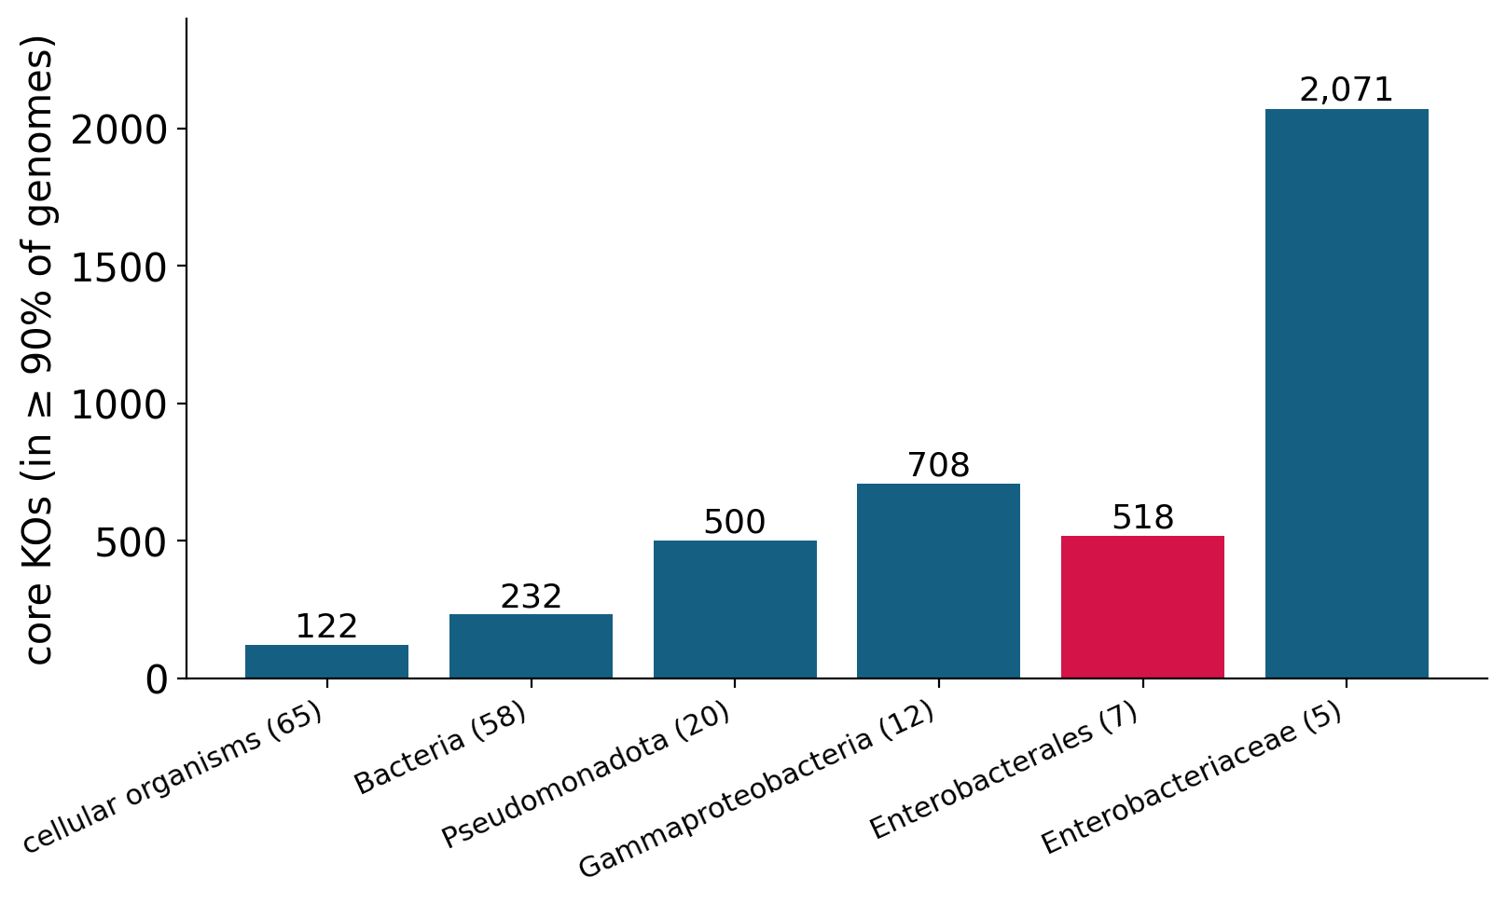
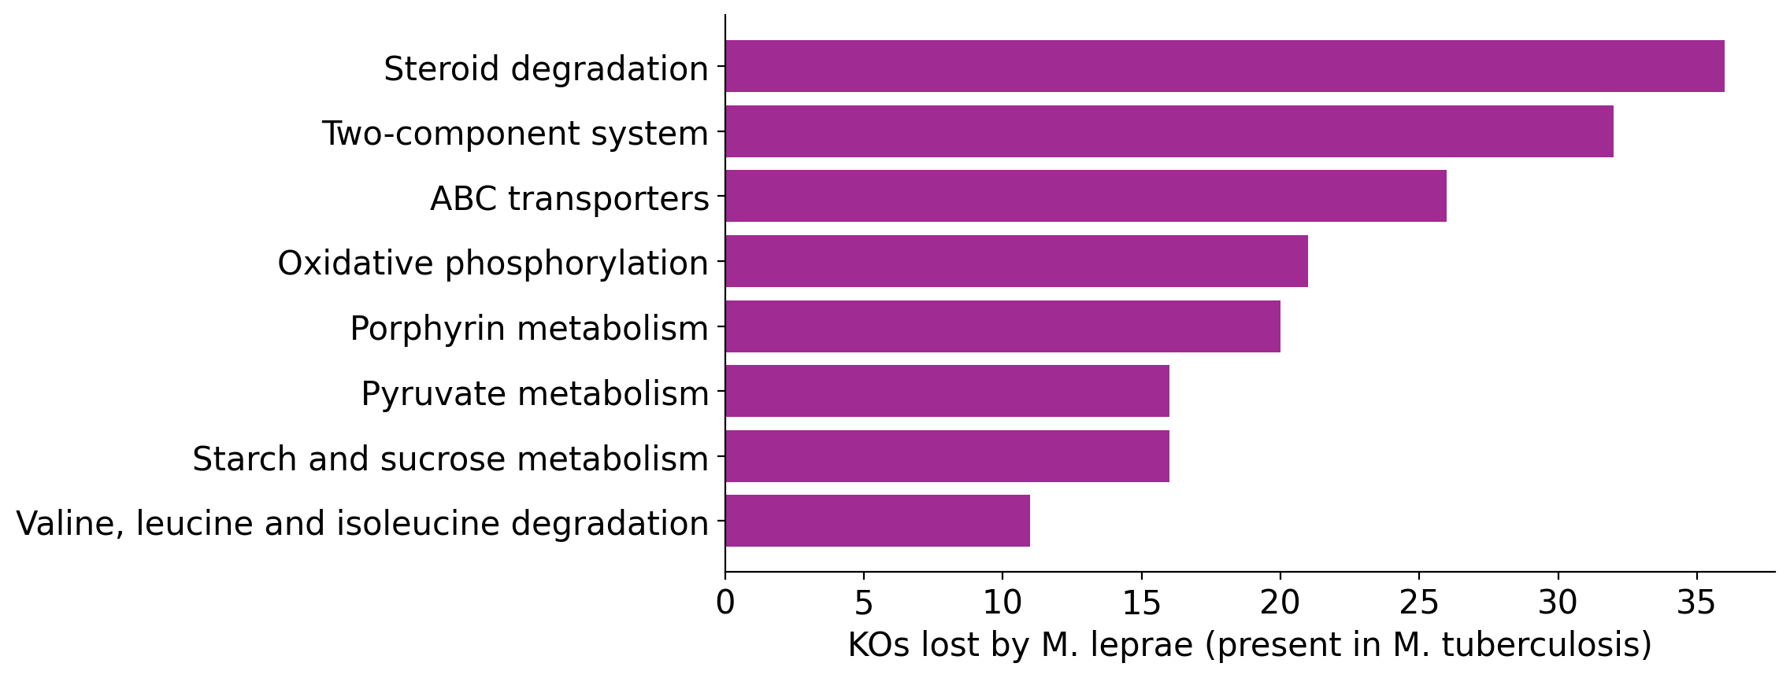
Genome reduction and gene loss
QUERY 2
Core = KOs in ≥ 90% of the genomes of a clade
The core grows towards narrow clades (122 → 2,071) …
… except at Enterobacterales: it contains Buchnera, a reduced genome that caps the core
M. tuberculosis → M. leprae: 668 KOs lost, only 15 gained
Lost: steroid degradation, signalling, transporters, respiration
Reductive evolution is mostly loss: a host-dependent lifestyle
NoSQL Databases for Bioinformatics · Lecture 27 · Neo4j genome workshop
‹#›
Notes:
Left: the core of a clade is the set of KOs carried by at least 90% of its genomes. Walking up the lineage of E. coli, from the root down to the Gammaproteobacteria, the core grows (122, 232, 500, 708 KOs): narrower groups share more. Then comes a surprise: the order Enterobacterales has a smaller core (518) than the family Enterobacteriaceae (2,071). Why? The order also contains Buchnera, the aphid endosymbiont with only about 570 KOs. A KO can only be in the core if almost every member has it, so one heavily reduced genome caps the core of the whole clade.
Right: gene loss between close relatives. Mycobacterium tuberculosis and M. leprae are close relatives, but M. leprae has a famously decayed genome. 668 KOs of M. tuberculosis are missing in M. leprae, while only 15 KOs are found only in M. leprae: reductive evolution is mostly loss. Adding the Pathway hop shows which functions disappeared: steroid degradation, two-component signalling, ABC transporters, oxidative phosphorylation. M. leprae lives inside human cells, where it no longer needs to catabolise diverse nutrients or sense a changing environment.

Slide 27
Be a sceptical scientist: limits and next steps
Limits of this analysis
Where to go next
Taxonomy ≠ phylogeny: a real tree comes from sequence alignments (e.g. the GTDB tree)
KO annotation is incomplete and biased to well-studied organisms: absent may mean not annotated
Presence / absence ignores gene order, copy number, sequence divergence
65 genomes is a small, uneven sample
Parsimony is a simplification: horizontal transfer breaks “one gain, then inherited”
Graph Data Science library: node similarity, communities, embeddings → Q1 on thousands of genomes
More node types: genes, proteins, phenotypes, habitats, resistance genes: new labels + a few relationships, no schema migration
Pangenome graphs: the sequence itself as a graph (pgv, previous lecture)
Knowledge graphs such as Hetionet: genes, diseases, drugs, tissues in one graph
Replace the taxonomy by a real phylogenetic tree (Newick → nodes + branches)
NoSQL Databases for Bioinformatics · Lecture 27 · Neo4j genome workshop
‹#›
Notes:
Every analysis has limits. Taxonomy is not phylogeny: a real tree is inferred from sequence alignments, for example the GTDB tree; the same graph model works, you would replace taxon_tree.csv by the nodes and branches of a Newick tree with branch lengths as relationship properties. KO annotation is incomplete and biased towards well-studied organisms, so 'absent' can mean 'not annotated'. Presence/absence ignores gene order, copy number and sequence divergence. Our 65 genomes are a small, uneven sample, so statements about single-genome clades are anecdotes. Parsimony is a simplification; horizontal gene transfer breaks the 'one gain, then inherited' assumption, and patchy KOs are exactly where this matters.
Next steps: the Neo4j Graph Data Science library (node similarity, community detection, embeddings) to run Q1 on thousands of genomes; more node types (genes, proteins, phenotypes, habitats, resistance genes) are just new labels and a few relationships, no schema migration; pangenome graphs, where the sequence itself is a graph (the pgv example from the previous lecture); knowledge graphs such as Hetionet that connect genes, diseases, drugs and tissues.

Slide 28
Recap: what you can do now
Objective | What we did | Key idea
Model genomic data as a graph | whiteboard recipe → Genome, KO, Taxon, Pathway + 4 relationship types | nouns → nodes, verbs → relationships; properties on both
Build a genomic graph database | constraints → batched UNWIND … MERGE → verification (65 / 8,994 / 270 / 356 nodes) | MERGE makes imports re-runnable; verify every import
Identify similar genomes from shared KOs | Genome → KO ← Genome, Jaccard index, heat map, kNN graph | normalise counts; results can be written back
Infer evolutionary patterns of KOs on a tree | CHILD_OF*0.., origin clade (LCA) + coverage, signature KOs, core, gene loss | most KOs are patchy; taxonomy ≠ phylogeny
The questions were about relationships: in a graph they are stored, so the query looks like the question.
NoSQL Databases for Bioinformatics · Lecture 27 · Neo4j genome workshop
‹#›
Notes:
Go back to the learning objectives of the session and tick them off. We modelled genomic data as a graph with a whiteboard recipe and design decisions; we built a graph database with constraints, batch UNWIND ... MERGE import and verification; we found similar genomes with the Genome -> KO <- Genome pattern and normalised with the Jaccard index; and we inferred evolutionary patterns of KOs across the taxonomic tree with variable-length paths, the lowest common ancestor ('origin clade') and its coverage, signature KOs, core shrinkage and gene loss.
The key sentence to remember: the questions of today were about relationships, and in a graph database the relationships are stored, so following them is cheap and the queries look like the question.

Slide 29
Check yourself
Best way to model “a genome contains a KO”?
1
A) a list property on the Genome node · B) a (:Genome)-[:CONTAINS_KO]->(:KO) relationship · C) merge Genome and KO into one node type
How do you find similar genomes by shared KOs?
2
A) count relationships on a Genome · B) find KOs with no genome · C) traverse Genome → KO → Genome and count
Why is the raw number of shared KOs a poor similarity score?
3
A) it cannot be computed in Cypher · B) it favours genomes with large repertoires · C) it ignores the tree
Which pattern lists all ancestors of a taxon?
4
A) -[:CHILD_OF]-> · B) -[:CHILD_OF*0..]-> · C) -[:CLASSIFIED_AS]->
Answers in the speaker notes · more questions and exercises with solutions in the workbook (Appendix B)
NoSQL Databases for Bioinformatics · Lecture 27 · Neo4j genome workshop
‹#›
Notes:
Answers. Question 1: B. KOs are shared entities, so they deserve their own nodes and the connection is a relationship (workbook section 2.2). Question 2: C. Traverse Genome -> KO -> Genome and count the shared KOs; counting relationships on one genome gives its size, not its similarity. Question 3: B. The number of shared KOs favours genomes with large repertoires; normalise, for example with the Jaccard index. Question 4: a variable-length path, -[:CHILD_OF*0..]->, starting at the genome's species; the same pattern works at any depth.
Practice at home: the workbook has exercises in sections 3, 5, 6 and 7 with folded solutions, Appendix A (Cypher cheat sheet), Appendix B (practice quizzes with answers) and Appendix C (troubleshooting).

Slide 30
Cypher cheat sheet
Description | Node | Relationship
generic | () | -- --> -[]-
with a reference | (n) | -[r]-
with a label / type | (:Genome) | -[:CONTAINS_KO]-
with a label / type + property | (:Genome {genome_id: 'eco'}) | -[:CONTAINS_KO {copies: 1}]-
variable + label + property | (g:Genome {genome_id: 'eco'}) | -[r:CONTAINS_KO {copies: 1}]->
variable length |  | -[:CHILD_OF*]-> *0.. *1..3
Task | Cypher | SQL analogue
find + filter | MATCH (g:Genome) WHERE … RETURN … | SELECT … FROM … WHERE
group + count | RETURN g.name, count(*) | GROUP BY (implicit in Cypher)
pipe a result on | WITH x, count(*) AS n WHERE n > 1 | HAVING / sub-select
get-or-create | MERGE (g:Genome {genome_id: 'eco'}) | INSERT … ON CONFLICT
optional match | OPTIONAL MATCH … | LEFT JOIN
delete with relationships | MATCH (n) DETACH DELETE n | DELETE … CASCADE
NoSQL Databases for Bioinformatics · Lecture 27 · Neo4j genome workshop
‹#›
Notes:
Reference slide. Nodes and relationships at a glance: () any node; (n) with a variable; (:Genome) with a label; (:Genome {genome_id:'eco'}) with a property; -[r:CONTAINS_KO {copies:1}]-> with variable, type and property. The same ideas appear in the workbook, Appendix A, together with a comparison with SQL. The official reference card is at https://neo4j.com/docs/cypher-cheat-sheet/ .

